Slide 1
Setup
Open these slides @ http://ap.pn/2myptQi
Download and install Node.js with the defaults: https://nodejs.org/en/download/
Note: Windows users may use the Node.js command prompt
Download and unzip the starter project: http://ap.pn/2ndk4jv
For Github instructions, click here
Download and install the latest version of Sublime (or preferred editor): https://www.sublimetext.com/
Open Sublime or IDE of choice
Install “Package Control” and “Babel”
Change the syntax highlighting to Javascript (Babel)
View > Syntax > Babel > Javascript (Babel)
Go to File > Open... > select the starter project folder

Slide 2

React Messaging App
(C) 2017 Appian Corporation. Distribution with attribution permitted. All other rights reserved
Notes:
Introduce Everyone

Slide 3
Why is React Useful?

Slide 4


What is React - Components and the DOM
Chat Box
👺
😈
🐼
🐵
🐼
💩
👻
Send
Notes:
Let’s say you have a complex view, with lots of different entry points (like facebook’s UI, or Appian’s).
We are going to refer to this UI in the browser as the DOM (Document Object Model).

Slide 5
What is React - Updating the UI
Chat Box
1
🐼
1
👺
🐼
🐵
🐼
💩
👻
Send
Notes:
Keeping the state of your UI consistent quickly becomes a challenge! Making a post should put the new post on the screen, sending notifications to others and updating the list of people you have messages with.

Slide 6
What is React - Centralized Logic for the View
Chat Box
1
🐼
1
State
👺
🐼
🐵
🐼
💩
👻
Send
Notes:
React simplifies this by centralizing where your ‘logic’ for the view lives.

Slide 7
What is React - Rebuilding the UI
Chat Box
1
🐼
1
State
👺
🐼
🐵
🐼
💩
set state
👻
New message
Send
Notes:
Rather than views modifying other views, they instead change the central logic which triggers a rebuild of the whole UI with the new data.

Slide 8
What is React - Re-Rendering
Chat Box
🐼
🐼
re-render
State
👺
🐼
🐵
💩
set state
👻
Send
Notes:
Rather than views modifying other views, they instead change the central logic which triggers a rebuild of the whole UI with the new data.

Slide 9
What is React - Re-Rendering
Database
Chat Box
🐼
🐼
State
👺
🐼
🐵
set state
💩
👻
Virtual DOM
Send
re- render
React.js
Notes:
Now, this sounds pretty expensive, to mitigate this React takes the View that you build and diffs it against what is currently on the screen and only updates the parts of the UI that changed.
This is called the React lifecycle

Slide 10
Setup
Open these slides @ http://ap.pn/2myptQi
Download and install Node.js with the defaults: https://nodejs.org/en/download/
Note: Windows users may use the Node.js command prompt
Download and unzip the starter project: http://ap.pn/2ndk4jv
For Github instructions, click here
Download and install the latest version of Sublime (or preferred editor): https://www.sublimetext.com/
Open Sublime or IDE of choice
Install “Package Control” and “Babel”
Change the syntax highlighting to Javascript (Babel)
View > Syntax > Babel > Javascript (Babel)
Go to File > Open... > select the starter project folder

Slide 11
Dependencies and Builds
Run npm install in the command line from the root of your project
This will download all the dependencies that are in your package.json file.
Notes:
On Windows you will run the command in the Node js Command Prompt that was installed with Node.js
On mac and linux you can use the command prompt

Slide 12


Setup - Dependencies and Builds
Libs
Webpack
Output Files:
js, html, css
Our Code
Notes:
This diagram describes the flow and tools that we use for building our project. And returning code a browser can handle.
npm (Node.js Package Manager) - takes care of getting your project dependencies
Our code
Webpack - A JS library that builds your project, and hosts it (locally)
package.json - tells npm which dependencies your project needs (also defines build targets)
webpack.config.js - Tells Webpack how to build your project

Slide 13

Setup - Dependencies and Builds
Webpack
index.js
index.html
package.json
webpack.config.js
App.jsx
Main.js
index.html
Notes:
Here are the different files we will be writing and where they fall in this process
Package.json is used for configuring npm and what it pulls
Webpack.config.js controls how webpack builds our project
Babel - a library for compiling jsx into js that will work on any browser.
And our code and the outputs of webpack. (next slide)

Slide 14
Setup - Key Files to Success
app.jsx: The entry point for our React app
main.js: This will be compiled into index.js by webpack (we defined it that way in webpack.config.js). It will load our React code
index.html: The first page of your application

Slide 15
Javascript and JSX Basics
Notes:
JSX is a syntax that combines HTML and JS -- not just a file type

Slide 16
= vs == vs ===
Like Java, Javascript uses different amount of = signs to denote different functions
B = A
Assigns the value of B as A
B == A
Asserts that B is equal to A
B === A
Asserts that B is equal to A, and checks for variable type
=== is more ‘strict’ then ==
1 == ‘1’ | True
1 === ‘1’ | False
Notes:
Also checks the type.
Use === as a default

Slide 17
Const, Let, Var
const | Variable is instantiated once and cannot be changed.
let | Variable can be changed and is scoped to the nearest enclosing block
var | Variable can be changed and scoped to the nearest function block

Slide 18


Const, Let, Var: Example
function() {
if (true) {
let b = ‘b’;
var c = ‘c’;
console.log(b);
console.log(c);
}
console.log(b);
console.log(c);
}

Slide 19
import React from 'react';
import Firebase from './firebase-wrapper';
const App = React.createClass({
getInitialState() {},
render() {}
});
export default App;
Each JSX file in our application will have two major sections:
The Imports
The Class

Slide 20
import React from 'react';
import Firebase from './firebase-wrapper';
const App = React.createClass({
getInitialState() {},
render() {}
});
export default App;
Imports are other modules that we bring into this file so we can can use them
We import React so we can use make a React class in this file.
We import Firebase so we can make calls to our server.

Slide 21
import React from 'react';
import Firebase from './firebase-wrapper';
const App = React.createClass({
getInitialState() {},
render() {}
});
export default App;
Classes Instantiation:
React.createClass({})
Function structure:
funcName() {
content
}
In order to import this class into other classes, we have to export this file by calling:
export default <class name>
Notes:
React.createClass is deprecated in the newest version of React.

Slide 22
Chat Box
All web pages are made out of modular components.
Our application:
The Application
Messages
The Input Box
Corresponding classes:
App.jsx
Message.jsx
Input.jsx
🐼
🐼
👺
🐵
💩
👻
Send

Slide 23
const App = React.createClass({
renderMessageDiv() {
….
}
render() {
const messageDivs = this.state.messages.map(this.renderMessageDiv);
….
}
});
In order to refer to variables and methods with class-level scope, the word “this” is very important.
this.renderMessageDiv
Calling “renderMessageDiv” in function without “this” will cause an error!

Slide 24
const App = React.createClass({
renderMessageDiv() {
….
}
render() {
const messageDivs = this.state.messages.map(this.renderMessageDiv);
….
}
});
Function calls in JS:
this.myFunc(<inputs>)
this.state.map(this.myFunc)
<div onClick={this.myFunc}>
Through the React Lifecycle
Covered later

Slide 25
const Input = React.createClass({
….
render() {
….
return (
<div>
<label> { label } </label>
<input id={ label } />
</div>
);
}
});
render()
responsible for displaying the component
Returns an html block
HTML Structure:
<component>content</component>
<component param-1 param-2/>
Call javascript in html using {}
<p>a</p> vs <p>{a}</p>
Notes:
render() returns 1 component, everything needs to be wrapped in a top level div

Slide 26
React Component Lifecycle
Mounting (Creating)
Updating
Unmounting (Destroying)
getInitialState/getDefaultProps
componentWillReceiveProps
componentWillUnmount
shouldComponentUpdate
componentWillMount
true
false
componentWillUpdate
render
render
componentDidMount
componentDidUpdate
Docs for the lifecycle methods
Notes:
React’s component lifecycle allows us to have more control over the stages that a component goes through in a predictable manner. Don’t worry about all of these methods - we will get to the relevant ones through our exercise, and this diagram is useful for seeing all the methods that are available for use.

Slide 27
// Import React and other stuff
import React ....
const App = React.createClass({
getInitialState() {
return {
messages: [] // Initialize empty list of messages
};
},
componentWillMount() {
// Turns on Firebase
},
componentWillUnmount() {
// Turns off Firebase
},
render() {
// shows your content on the screen
}
});
export default App;
App.jsx
Mounting (Creating)
getInitialState/getDefaultProps
componentWillMount
render
componentDidMount

Slide 28
// Import React and other stuff
import React ....
const App = React.createClass({
getInitialState() {
return {
messages: [] // Initialize empty list of messages
};
},
componentWillMount() {
// Turns on Firebase
},
componentWillUnmount() {
// Turns off Firebase
},
render() {
// shows your content on the screen
}
});
export default App;
App.jsx
Updating
componentWillReceiveProps
shouldComponentUpdate
true
false
componentWillUpdate
render
componentDidUpdate

Slide 29
// Import React and other stuff
import React ....
const App = React.createClass({
getInitialState() {
return {
messages: [] // Initialize empty list of messages
};
},
componentWillMount() {
// Turns on Firebase
},
componentWillUnmount() {
// Turns off Firebase
},
render() {
// shows your content on the screen
}
});
export default App;
App.jsx
Unmounting (Destroying)
componentWillUnmount
Notes:
Kills the connection to the server

Slide 30
Let’s Jump Right In
Notes:
Emphasize that we want people to follow along more than typing along during the workshop

Slide 31
Let’s run our app!
Once npm install has completed, we can run npm run start from the command line. This will deploy our project.
Go to localhost:8081 in your browser to see your app!
Notes:
Stop for 1-2 minutes to ask for questions or wait for them to catch up

Slide 32
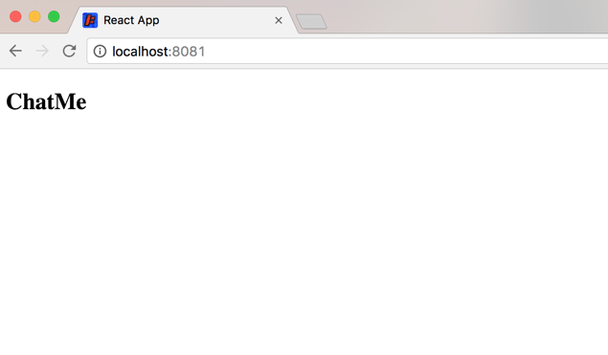
Let’s run our app!

Slide 33
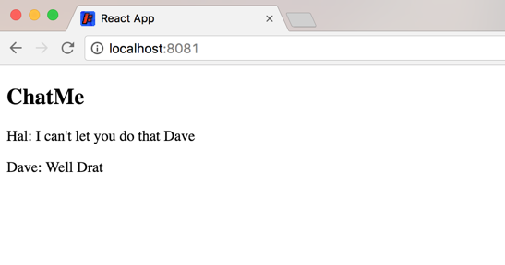
Showing the Firebase Messages

Slide 34
Showing the Firebase Messages
We are going to use Firebase to host the messages for our chat application.
First, let’s display the pre-recorded messages from our database
See the changes here!

Slide 35
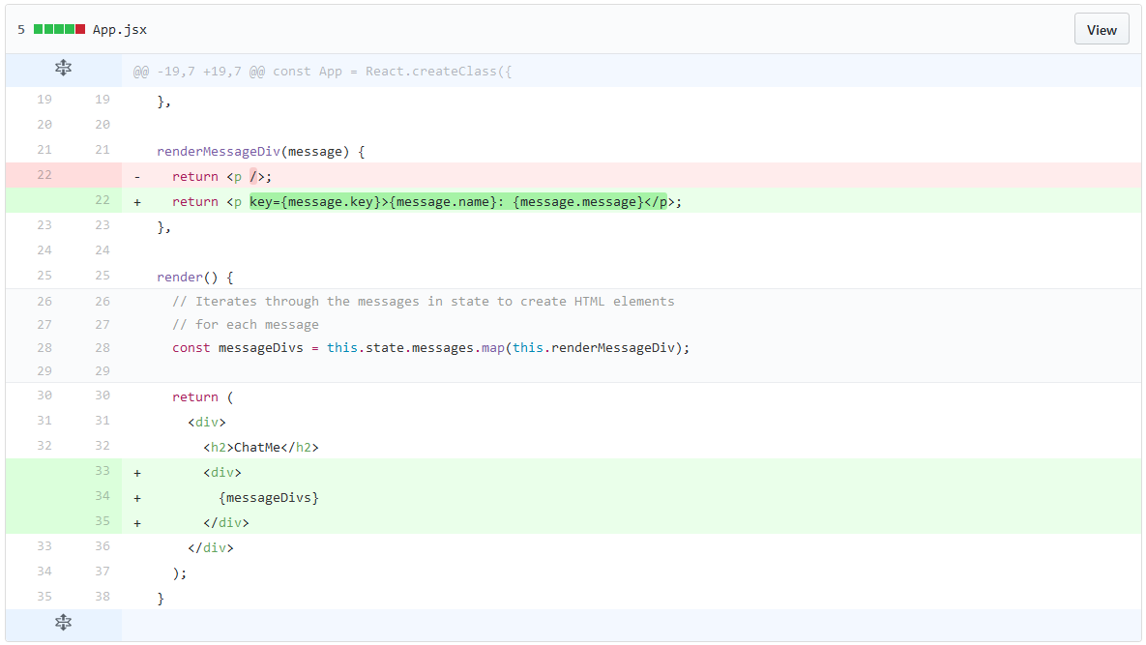
Showing the Firebase Messages
Red lines should be removed
Green lines should be added

Slide 36
Showing the Firebase Messages

Slide 37
Showing the Firebase Messages

Slide 38
Showing the Firebase Messages

Slide 39
Common React/JS mistakes and Best Practices
Syntax errors, like missing , . ; { or (
Mixing up , with . OR ( with {
Misspellig or mis-caSing variable names
Missing keywords like var, const, let or import
Notes:
Link to handout: https://docs.google.com/document/d/1PFxSwu9vYmv1dOBGvVwo4xHQJ82-fv8E83LvsqO2VqQ/edit

Slide 40
const Input = React.createClass({
propTypes: {
label: React.PropTypes.string,
value: React.PropTypes.string,
onChange: React.PropTypes.func,
onKeyPress: React.PropTypes.func
},
render() {
const label = this.props.label;
const value = this.props.value;
….
}
});
Props = values that are passed into a component
Props are immutable (can’t be changed)
Our application would pass props down to each message.
You can access props anywhere in your class by calling this.props.

Slide 41
const Input = React.createClass({
propTypes: {
label: React.PropTypes.string,
value: React.PropTypes.string,
onChange: React.PropTypes.func,
onKeyPress: React.PropTypes.func
},
….
});
Every class has to define what props it can accept.
Format:
propTypes: {
<prop name>: <variable type>,
<prop name>: <variable type>,
...
}

Slide 42
Making A Component
You can make React components to modularize the UI
We are going to make each message a component
See the changes here!
Notes:
While having each message as a component may not have a lot of value right now, it will be helpful to see how we make React components and we’ll add some more complex logic later on.
Go over why components are useful

Slide 43
Destructuring Assignments
const {name, message} = this.props.message;
is the same as:
const name = this.props.message.name;
const message = this.props.message.message;

Slide 44
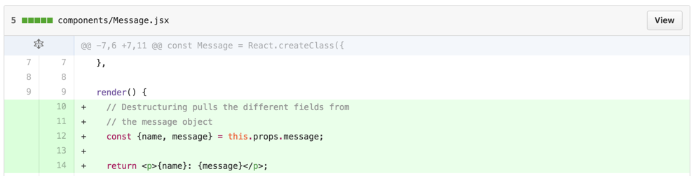
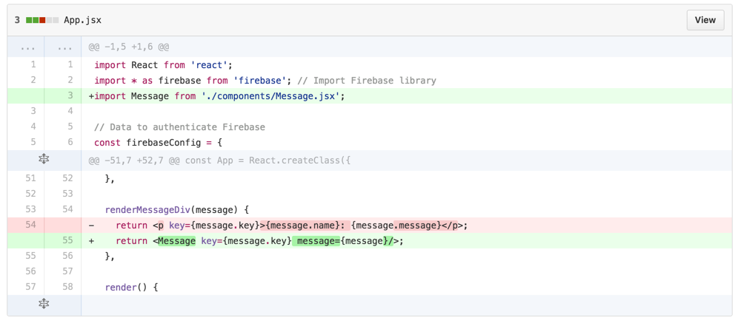
Making A Component
Notes:
start off by saying we are going to make a component for our messages, remove p key tag and use the component we’re importing
While having each message as a component may not have a lot of value right now, it will be helpful to see how we make React components and we’ll add some more complex logic later on.

Slide 45
Making A Component
Notes:
While having each message as a component may not have a lot of value right now, it will be helpful to see how we make React components and we’ll add some more complex logic later on.

Slide 46
Making A Component
Notes:
While having each message as a component may not have a lot of value right now, it will be helpful to see how we make React components and we’ll add some more complex logic later on.

Slide 47
Making A Component
Notes:
While having each message as a component may not have a lot of value right now, it will be helpful to see how we make React components and we’ll add some more complex logic later on.
By replacing the <p> tag with the <message> tag we are effectively calling the render method of the message component and placing its return value in the App.jsx

Slide 48
Making A Component
Notes:
While having each message as a component may not have a lot of value right now, it will be helpful to see how we make React components and we’ll add some more complex logic later on.

Slide 49
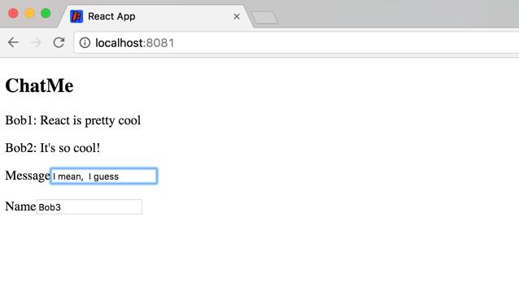
Adding new Messages

Slide 50
Adding new Messages
For both name and message we need both an input and a label
Our message will be sent to the server when we hit Enter, then the message field will be cleared.
See the changes here!
Bonus: Play around with the events to make the message send with different keys

Slide 51
const App = React.createClass({
getInitialState() {
return {
name: ‘ ‘
};
},
….
render() {
const nameDiv = <p>{this.state.name}</p>
….
}
});
Every React component has internal state
State is mutable
In this example, the state variable is name
Notes:
State represents data that can change inside a component
Messages are one of the things in the state that can change

Slide 52
const App = React.createClass({
getInitialState() {
return {
name: ‘ ‘
};
},
….
render() {
const nameDiv = <p>{this.state.name}</p>
….
}
});
State has class-level scope
this.state.variableName
getInitialState()
sets state variables when the web page is first rendered.
We are initializing our name to be an empty string.
Notes:
Anything within the class schema can use state
Our app messages is initially blank, but will be updated by Firebase; render will go through all of the messages in the state to display

Slide 53
const Input = React.createClass({
….
onChange() {
if (this.state.name == null) {
this.setState({ name: “bob2” })
}
},
….
});
Change state variables by calling:
this.setState({ name : value })
Causes the component to re-render

Slide 54
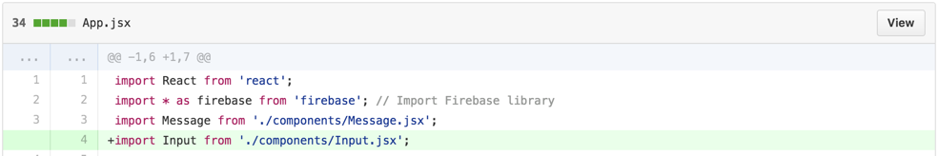
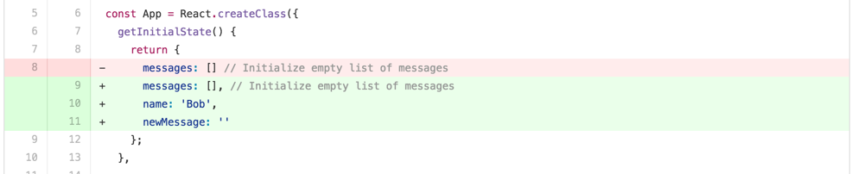
Adding new Messages

Slide 55
Adding new Messages

Slide 56
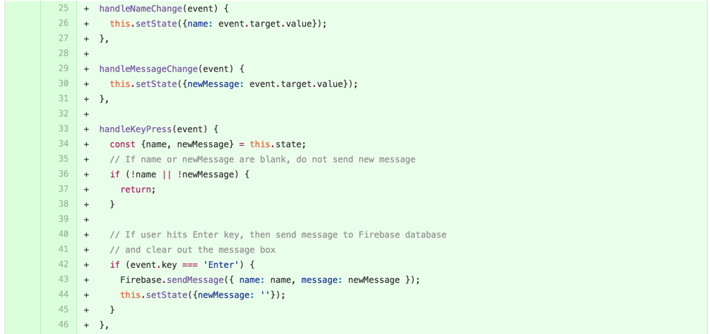
Adding new Messages
Notes:
Components needs to receive events and javascript will handle the events

Slide 57
Adding new Messages

Slide 58
Adding new Messages

Slide 59
Adding new Messages

Slide 60
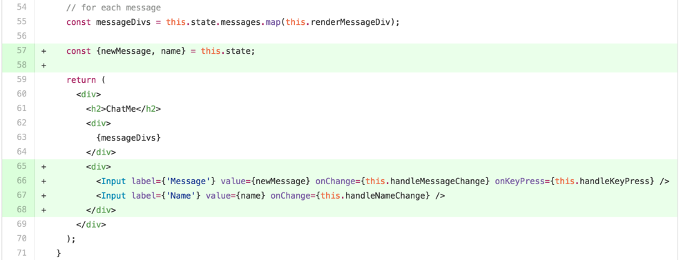
Adding new Messages

Slide 61
Adding new Messages

Slide 62
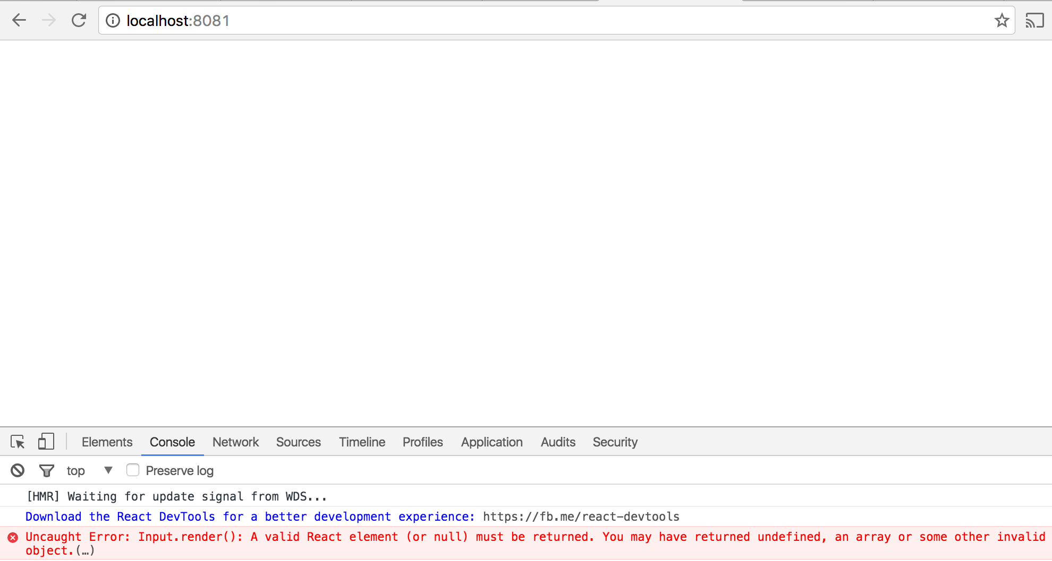
...because we’re not done!

Slide 63
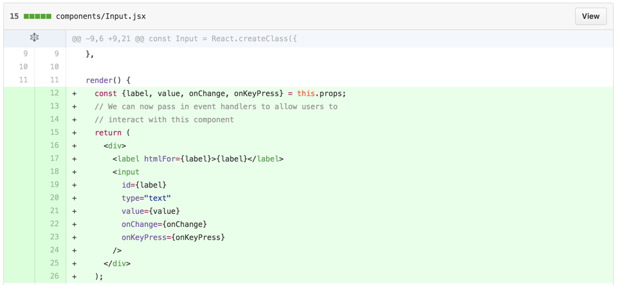
Adding new Messages

Slide 64
Adding new Messages

Slide 65
Adding new Messages

Slide 66
Adding new Messages

Slide 67
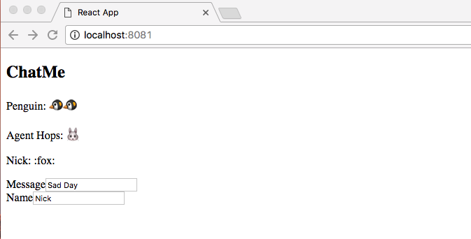
Adding Emoji Support

Slide 68
Adding Emoji Support
Go to your message component and add the library.
See the changes here!
Try:
:thumbsup:
:panda_face:
:money_with_wings:
:alien:
:speedboat:
link to more emojis

Slide 69
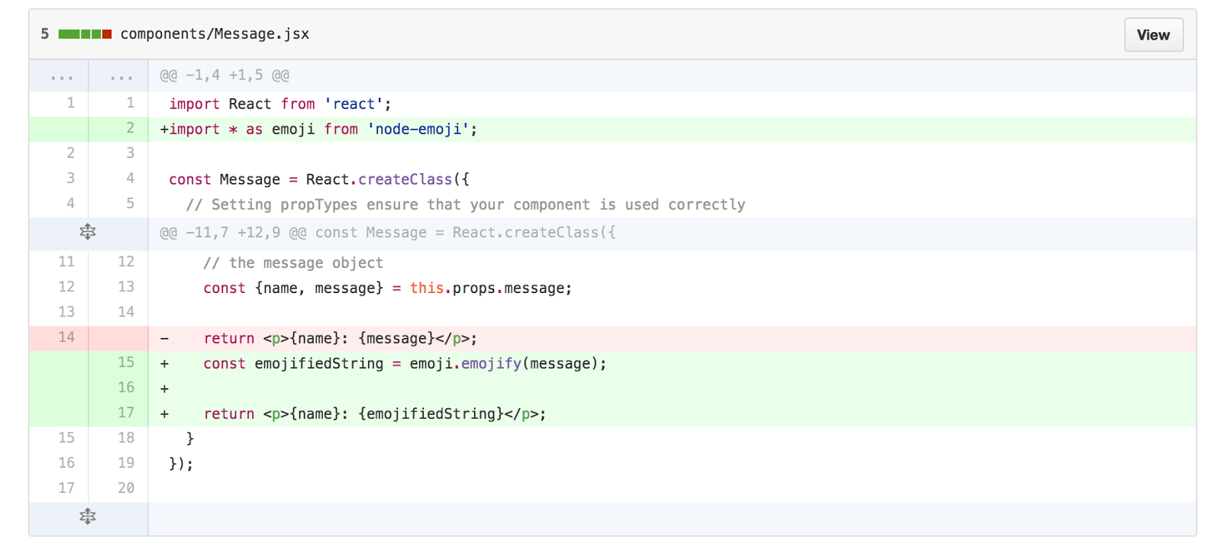
Adding Emoji Support

Slide 70
Adding Emoji Support

Slide 71
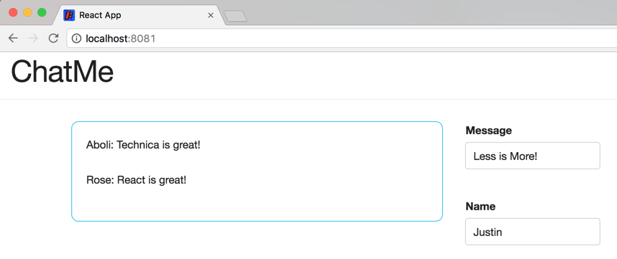
Styling our Interface

Slide 72
Styling our Interface
Our stylesheet is already included in the styles/ directory
Let’s import it and update our components to use the styles.
See the changes here!
Bonus: Change the class names on the different divs and see how the styles change

Slide 73
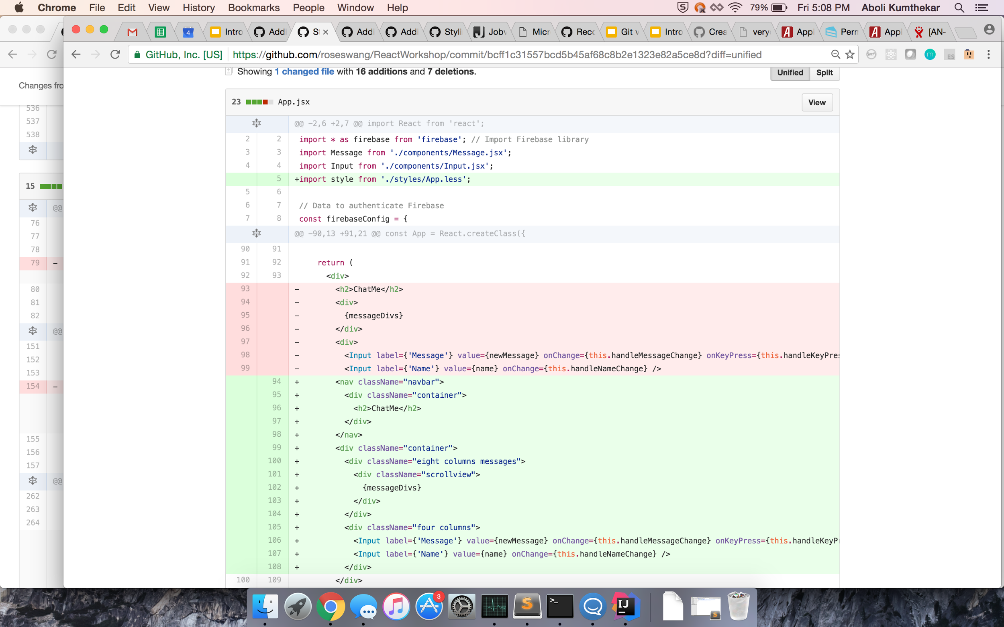
Styling our Interface

Slide 74
Styling our Interface

Slide 75
You're Done!
Everything Should Work Now!

Slide 76
More Common React/JS mistakes
Missing imports
Forgetting to install libraries before using them
Not updating the state using setState on user interaction
Confusing =, ==, and ===
Accessing a variables in the wrong scope
Check out this video
Notes:
Link to handout: https://docs.google.com/document/d/1PFxSwu9vYmv1dOBGvVwo4xHQJ82-fv8E83LvsqO2VqQ/edit

Slide 77
Questions?

Slide 78
Github Setup
In order to get this project your device, run the following command
git clone git@github.com:mdeng123/ReactWorkshop.git
Running this previous command gives you all the commits in the project.
Feel free to do with the code as you like, and if you want to follow along, run the following command, which will set your project to the beginning.
git checkout 6d6b5de0674b45dcd0380649d7352569bf00072f
As we move through the workshop, we will show the necessary changes needed for each step of the project. Please feel free to code with us or just listen.
If you just choose to listen, the next slide provides git commands to keep your code up to date as we move through the presentation. Each command is coupled with the title of where we are in the workshop.
Notes:
Link to handout: https://docs.google.com/document/d/1PFxSwu9vYmv1dOBGvVwo4xHQJ82-fv8E83LvsqO2VqQ/edit

Slide 79
Git hashes
Git Command | Workshop Stage
git checkout 6d6b5de0674b45dcd0380649d7352569bf00072f | Starter Project
git checkout ed93d67aef63b5a273b8064c49bb89a935e50ddb | Show the Firebase Messages
git checkout df9915737183f9afa37e48eee23f3cd5faabbde7 | Making a Component
git checkout a5eb99de3c4f8cff1c19e97d5ac2ca771da279ae | Adding New Messages
git checkout 964bffed1defcf672b1aeb47c30732cadc9a7723 | Styling the Interface
git checkout f6b49e6946135564012021a4f348dd508fa6217c | Adding Emoji Support

